Slide 1

Tier Splitting using Static Analysis
Presenter ： Xinran AI
Promoter：Prof. Dr. Coen De Roover
Supervisors: Laure Philips
Jens Nicolay
Notes:
Hello, everybody. My name is Xinran AI. I am going to present my thesis，the title is tier splitting using static analysis

Slide 2
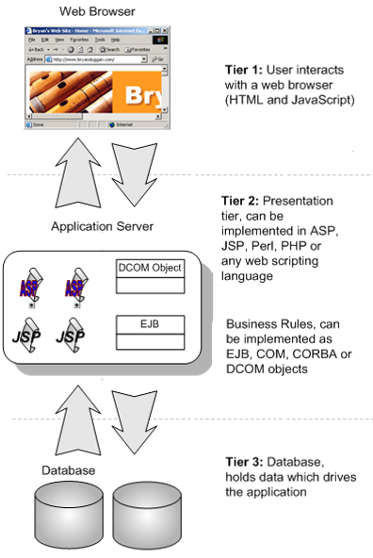


Problem Statement
Typical tree-tier architecture vs. Tierless programing language
- Investment of novel language
- Effort to familiar with a new programming language
- Effort on annotate tier information
- Error-prone
2
Notes:
Now, let’s start with problem state. Today, people can use web application in everywhere and the diverse functionalities make our live more and more convenience. And also increasing of interactive features make development in typical three tier more complexity than before. Because in typical three tier architecture each tier have its own technique stack, like what is shown in this picture. And it requires manual combination to glue each tier. Aiming to reduce this kind of complexity, tierless program language emerges at the right moment. This technique enable developers to build a web applicaition as a single-tier application, then automatically distribute the single-tier program into multi-tiers.Some current solution invest on a novel programming language. In this case, developers have to spend time on getting familiar with a new language. And normally this novel technique requires developer annotate tier information carefully. So in some way, it doesn’t reduce the effort on development web application.

Slide 3


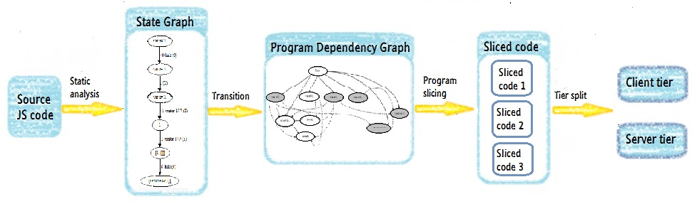
Problem Statement
Existing technology with distributed features can be
catered for tier splitting, Node.js.
Existing solution
A tierless splitting tool only require annotate code with
@client and @server.
3
Notes:
So we turn to extend current technology. Such as, JavaScript which is used to run in browser and now is seeing increased adoption on the server tier. In the view of expandability of JavaScript, we already allow our tier splitting tool named Stip.Js to distributed tierless JavaScript code into client and server tier. And Stip.js only requires developers annotate their code with @client and @server. To completes tier splitting, Stip is based on following idea. first using static analysis based on abstract interpretation to analyse the source code and result in state graph. Then Construct Program Dependence Graph(PDG) on top of state graph. And Apply program slicing technique on PDG to generate sliced code. Then distribute sliced code into client tier and server tier.

Slide 4
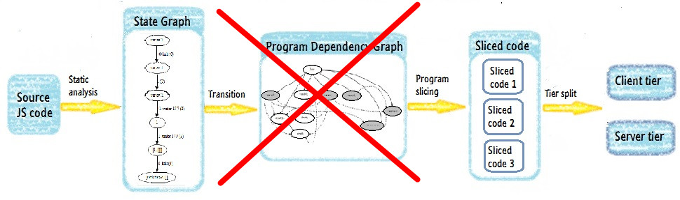
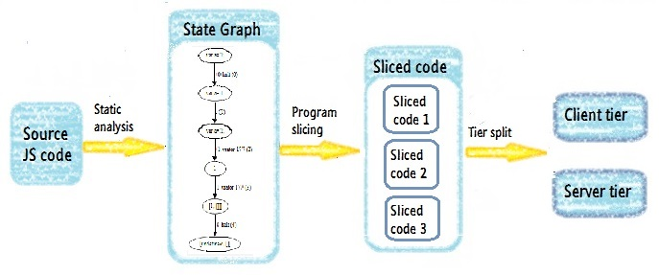
Problem Statement
New slicing algorithm: JipdaSlicer
4
Notes:
The motivation of my thesis is try to develop in a new slicing algorithm which can slice on state graph directly.

Slide 5
Related work
Program slicing
Abstract Interpreter
5
Notes:
Now I will introduce two theoretical foundation of my thesis.

Slide 6
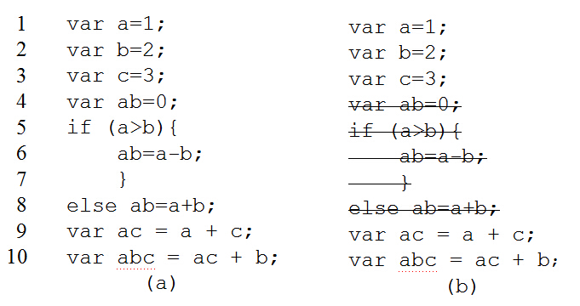
Program Slicing
Weiser’s static program slicing theory:
Definition:
A slice S of program P, is obtained from a specific slicing criterion denoted as a pair of value <i, V>, where i is the line number of statement in P, and V is set of variables defined or used at i.
A slice S can be obtained by deleting zero or more statements from program P. Meanwhile, P and S must behave the same with respect to <i,V>.
Figure 1(a) source JavaScript program; (b) get slice S out of slicing criteria <10,{abc}>
6
Notes:
Program slicing is first proposed by Weiser. The definition is : If we use i to denote the line number of a statement in program and V is set of variables defined or used at i. the program slice on line I is obtained by delete one or more statements from program. And only keep the statements which have effect on the variables in line i. and the slicing result must keep same behavior as it involved in original program. Weiser’s program slicing theory is established on flow graph. In his flow graph, Node denotes for statement in program and edges is flow relations between nodes. The process of slicing is done by data analyasis on flow graph.

Slide 7
Program Slicing
Static slicing on Program Dependency Graph(PDG)
PDG proposed by J. Ferrante et al..
Data dependency in PDG
If a statement S’ use the variable defined at statement S without redefining of this variable during the execution, then statement S’ is data dependent on statement S.
Control dependency in PDG
If a statement S’ is control dependent on statement S, there will be two edges out of S, the “True” edge will lead to execute on S’, “False” edge will lead the program jump to another statement.
7
Notes:
In later, J. Program Dependency Graph is most intermediate representation of program used to get program slice. Similar with Weiser‘s theory, the node in PDG is represent for statement and edge is dependences between each node. And each PDG has an entry node to denote the entry of program. Two very important concept in PDG is data dependency and control dependency between node. The data dependence is:
The control dependence is: . So when we construct PDG we have to analyse the different dependences relations between each node. And built property edges between node. The slice is obtained by back traversal on PDG from selected node.

Slide 8
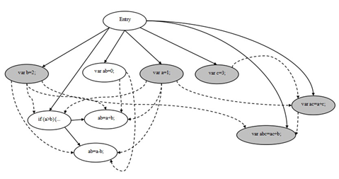
Program Slicing
Static slicing on Program Dependency Graph(PDG)
Backward traversal
1
2
3
4
5
6
7
8
9
10
var a=1;
var b=2;
var c=3;
var ab=0;
if (a>b){
ab=a-b;
}
else ab=a+b;
var ac = a + c;
var abc = ac + b;
Program slicing on slicing criteria <10,{abc}>
8
Notes:
This picture explain how to get program slice on PDG. The gray node is the slice on slicing criterion <10,{abc}>. In the figure, a solid line denotes a control dependency, a dashed line denotes a data dependency. Slicing starts by searching the node that represents line 10, and then traverse backward along dependency edges from it and mark all the visited nodes. In the first traversal, nodes represent for statement in line 2 and line 9 are visited. In second step, backward traverse the dependences edges from the node you marked in first traversal. Iterative second step until all marked node on the path from slicing node to entry node.

Slide 9
Abstract Interpreter
CESK-machine abstract interpreter
program state consist of four components: a (C)ontrol component, a (E)nvironment, a (S)tore and a (K)ontinuation.
C: expression in functional programming
E: map a variable to its address
S: map an address to its value
K: the continuation state of current symbol
CESK-machine result in state graph
9
Notes:
CESK-machine is a machine based abstract interpreter which can used to analyse the behavior of source language and translate it into target language. ” It decompose program into four components” The evaluate of atomic expression is always return itself.

Slide 10
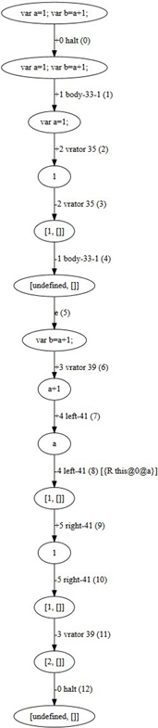
Example of State graph
Connect with cesk-machine
C: expression
E: map a variable to its address, is used to keep
scope information.
S: map an address to its value
K: next symbol to be evaluated of current node
Example code:
var a=1;
var b=a+1;
Positive edge: push stack
Negative edge: pop stack
Line number
Tag (id)
Identifier
Scope
10
Notes:
By given two statement as shown in slide. We get the state graph as in right. From the code we can know, the second line is data dependent on first line. In state graph, The digit in parentheses on the edges is the edges’ number. Each edge also contains stack information of the abstract interpreter. This consists of a tag of a node. This tag can be seen as an id of each block. The block in a state graph is the node between corresponding positive and negative edges. This node may be a function declaration or an operand in code. A number of blocks compose more complex semantics, such as variable declaration, function call. For example, statement in first line is identified with two blocks: node between edge +1 and -1 identify the value of variable, then edge +2 and -2 identify variable declaration statement. For some edges, it also contains reference and scope information such as the 8th edge. 8th edge tells us, this node refers to an identifier whose value is a, and the scope of a is point to global variable. The edges labeled with positive digit denote for the operation of push stack; on contrast, negative digit denotes for operation of pop stack. In our CESK-machine, push stack indicates the start of evaluation of an identifier or a statement; pop stack indicates the evaluation is terminated. Each corresponding positive and negative digit pair is used to identify semantics of the program.

Slide 11
Approach: program slicing on state graph directly
11
Notes:
Now I will introduce the case study of new slicing algorithm

Slide 12
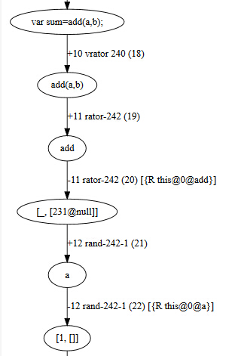
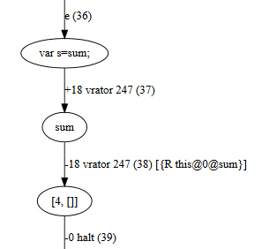
Approach
Make assumption
Check on direct and indirect data and control
dependences.
Define a function name add with two formal parameters.
Call add function in after the definition
Assign the result of invoking of function add to a variable.
.….
12
Notes:
By given two statement as shown in slide. We get the state graph as in right. From the code we can know, the second line is data dependent on first line. In state graph, The digit in parentheses on the edges is the edges’ number. Each edge also contains stack information of the abstract interpreter. This consists of a tag of a node. This tag can be seen as an id of each block. The block in a state graph is the node between corresponding positive and negative edges. This node may be a function declaration or an operand in code. A number of blocks compose more complex semantics, such as variable declaration, function call. For example, statement in first line is identified with two blocks: node between edge +1 and -1 identify the value of variable, then edge +2 and -2 identify variable declaration statement. For some edges, it also contains reference and scope information such as the 8th edge. 8th edge tells us, this node refers to an identifier whose value is a, and the scope of a is point to global variable. The edges labeled with positive digit denote for the operation of push stack; on contrast, negative digit denotes for operation of pop stack. In our CESK-machine, push stack indicates the start of evaluation of an identifier or a statement; pop stack indicates the evaluation is terminated. Each corresponding positive and negative digit pair is used to identify semantics of the program.

Slide 13
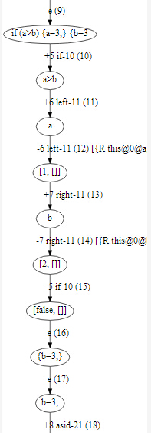
Approach
Make assumption
Checking on state transition of conditional statement.
example code:
var a = 1;
var b = 2;
if(a>b){
a=3;
}else{
b=3;
}
13
Notes:
This slide show the examination of conditional statement. For each predicates expression, the state graph returns a Boolean result of expression. And the clause will be accessed only when the result is true. And the data dependence in predicates is identified in same way as we introduce in precious slide.

Slide 14
Approach
Three assumptions:
Directly influence statement and variable is found by matching identifiers and scope information on the edges.
Iteratively to query on dependent node we get in each stage of query to find indirectly influence statement and variable.
Replace the code in clause result from false predicates with null value.
Our program slicing is conform to Weiser’s theory:
Algorithm is derived by input slicing criterion<i,V>
i is the line number of selected line.
V is the variable name in selected line.
14
Notes:
So we put forward three assumption based on our aboservation.

Slide 15
Implementation
15
Notes:
Now I’ll elaborate the implementation

Slide 16
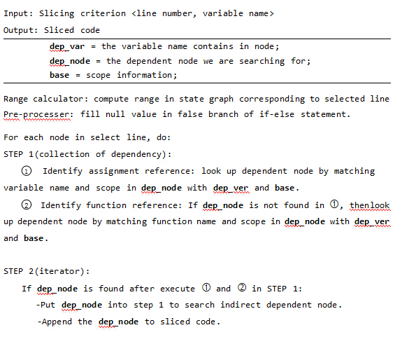
Implementation
16
Notes:
This picture shows the outline of implementation based on our assumption. First we need to get the range of statement used to start slicing algorithm in state graph. Then traverse each node in this range and put each node in the dependency query function. As JavaScript allow to define functions in two ways. We need two look up functions to map identifier reference. And if we find the dependent node, the algorithm launch the iterator function to find indirect dependent node and append it to sliced code.

Slide 17
Validation
17
Notes:
Next part is validation. This part is done by comparing the slicing result out of the two slicing algorithm.

Slide 18
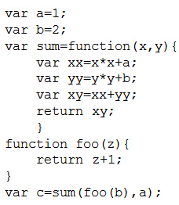
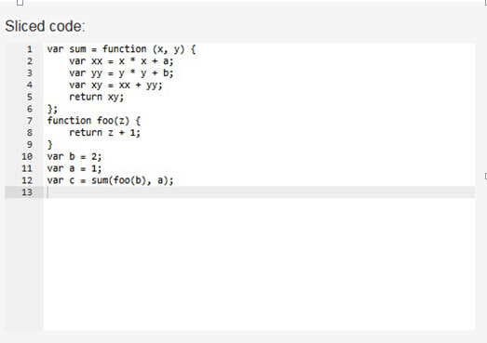
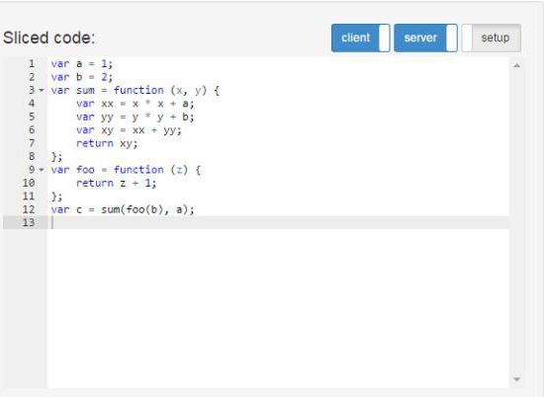
Evaluation
1
2
3
4
5
6
7
8
9
10
11
12
Slice on slicing criterion <12,{c}>
JipdaSlicer
Stip.js
18
Notes:
After test some cases of function invocation, we found both algorithm is good enough to deal with data dependency and control dependency involved in function call. This is the case of interpreocedural function invocation. As we can see from the results, the different is in the order of statement in result. The different way of querying results in this kind of different ordering. In JipdaSlicer, after abstract interpreter invoked by getting the range of selected line, the algorithm evaluates each node in that line in sequence. If the node is bundled with identifier, the node on which it dependent is always found by traversal on state graph to matching the name of variable with scope. So the order of code in the result from JipdaSlicer depends on the position of identifier in selected line.

Slide 19
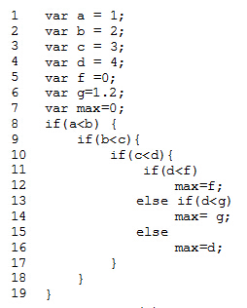
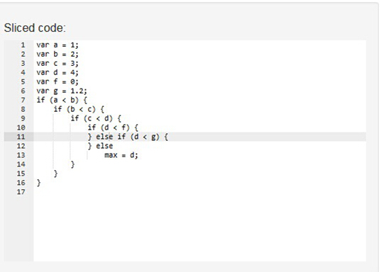
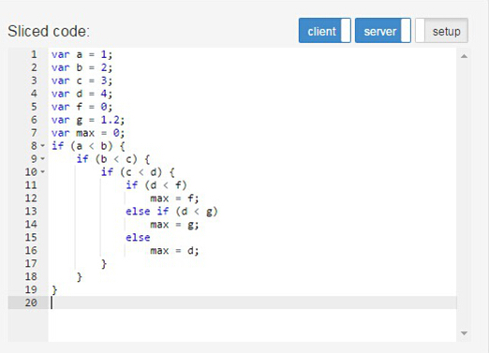
Evaluation
Slice on slicing criterion <16,{max}>
JipdaSlicer
19
Stip.js
Stip.js
Notes:
This is the situation of slicing on conditional statement. To conform our assumption, the result of slicing is return an empty block of false clause. However, in stip in order to keep the syntax structure, it keeps all clause in if-else statement.

Slide 20
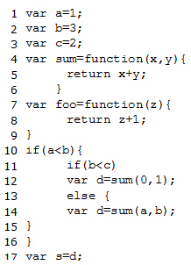
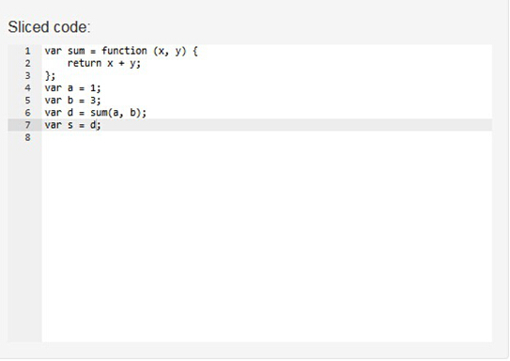
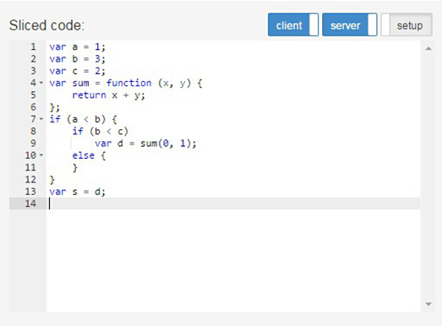
Evaluation
Slice on slicing criterion <17,{s}>
JipdaSlicer
20
Stip.js
Stip.js
Notes:
This test case is in order to examine the different slicing mechanism of slicing conditional statement in JipdaSlicer. If the selected line is not involved in any clause of if-else statement, the result won’t show the syntax structure of conditional statement. The sliced code only involves the statement which is executed during the computation of program. So in this example , the sliced code only keep the statement in line 14 of source code.

Slide 21
Conclusion
21
Notes:
Now let me give the summarize of my thesis.

Slide 22


Conclusion
Output is correct.
In conditional statement, return empty branch of if depend on predicates.
Support less syntax than original version of Stip.js
Limited to linear graph
22
Stip.js

Slide 23
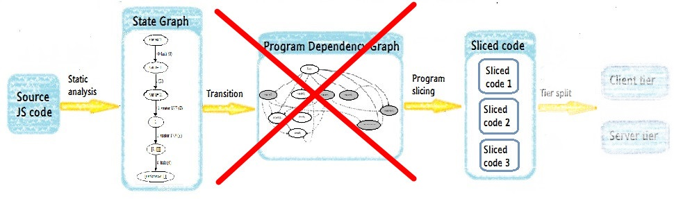
Contribution
Examine if the program dependency graph is necessary to acquire a correct slice of a program.
Isolates dependencies query from analysis complexity graph structure.
Correctly reflect syntax structure of conditional statement.
23

Slide 24
Future work
Interpreter design
To process more syntax structure, such as loop statement like while, for
Distributed code
To be able to generate distributed sliced code in Node.js and Meteor.js framework.
Algorithm performance
A dynamic programming algorithm to reduce time complexity of our algorithm
24

Slide 25
Thank you!
Any Questions?
25

